Slide 1
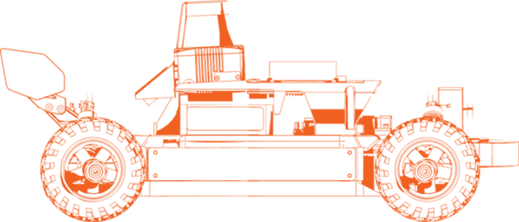


LAB-03
Reactive Autonomy
Chinmay Vilas Samak
Ph.D. Candidate
ARMLab, CU-ICAR
Email: csamak@clemson.edu
Tanmay Vilas Samak
Ph.D. Candidate
ARMLab, CU-ICAR
Email: tsamak@clemson.edu

Slide 2

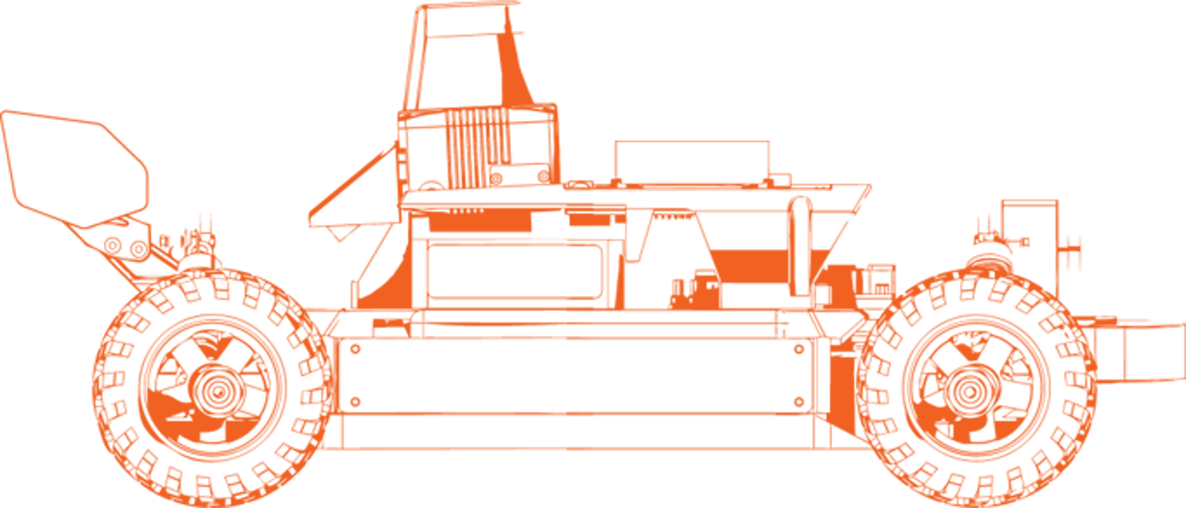


Lab Outline and Expected Outcomes
Emergency braking
  Formulation A: Single measurement
  Formulation B: Multiple measurements
Wall following
  Formulation A: Follow just one wall
  Formulation B: Follow both the walls
Gap following
  Formulation A: Naïve gap follower
  Formulation B: Disparity extender
GOAL: Perception-enhanced vehicle control

Slide 3
Emergency Braking

Slide 4
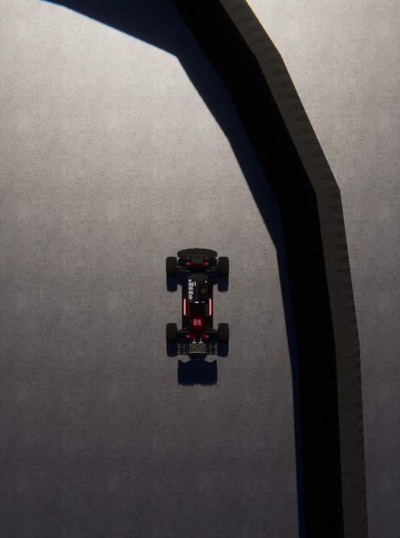

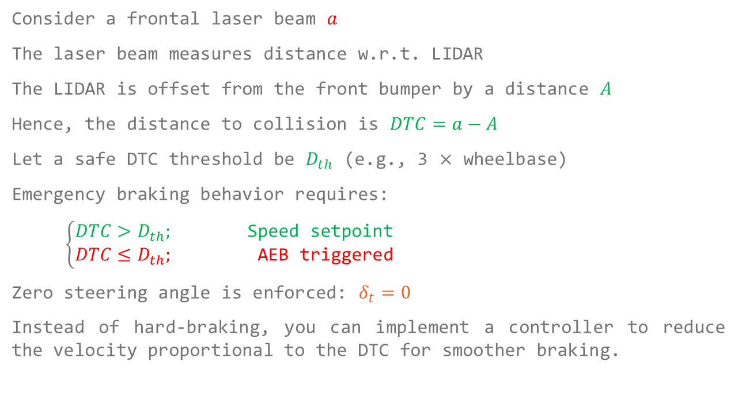


Formulation A: Single Measurement
Consider a frontal laser beam $a$
The laser beam measures distance w.r.t. LIDAR
The LIDAR is offset from the front bumper by a distance $A$
Hence, the distance to collision is $DTC=a−A$
Let a safe DTC threshold be $D_{th}$ (e.g., 3 $×$ wheelbase)
Emergency braking behavior requires:
$\left\{\begin{aligned}DTC>D_{th};\text{ Speed setpoint} \\ DTC≤D_{th}; \text{AEB triggered}\end{aligned}\right.$
Zero steering angle is enforced: $δ_{t}=0$
Instead of hard-braking, you can implement a controller to reduce the velocity proportional to the DTC for smoother braking.
$$DTC$$
$$a$$
$$A$$

Slide 5
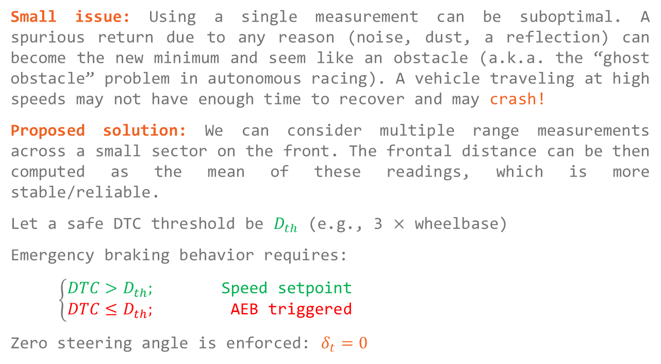
Formulation B: Multiple Measurements
Small issue: Using a single measurement can be suboptimal. A spurious return due to any reason (noise, dust, a reflection) can become the new minimum and seem like an obstacle (a.k.a. the “ghost obstacle” problem in autonomous racing). A vehicle traveling at high speeds may not have enough time to recover and may crash!
Proposed solution: We can consider multiple range measurements across a small sector on the front. The frontal distance can be then computed as the mean of these readings, which is more stable/reliable.
Let a safe DTC threshold be $D_{th}$ (e.g., 3 $×$ wheelbase)
Emergency braking behavior requires:
$\left\{\begin{aligned}DTC>D_{th};\text{ Speed setpoint} \\ DTC≤D_{th}; \text{AEB triggered}\end{aligned}\right.$
Zero steering angle is enforced: $δ_{t}=0$
$$DTC$$
$$a$$
$$A$$

Slide 6
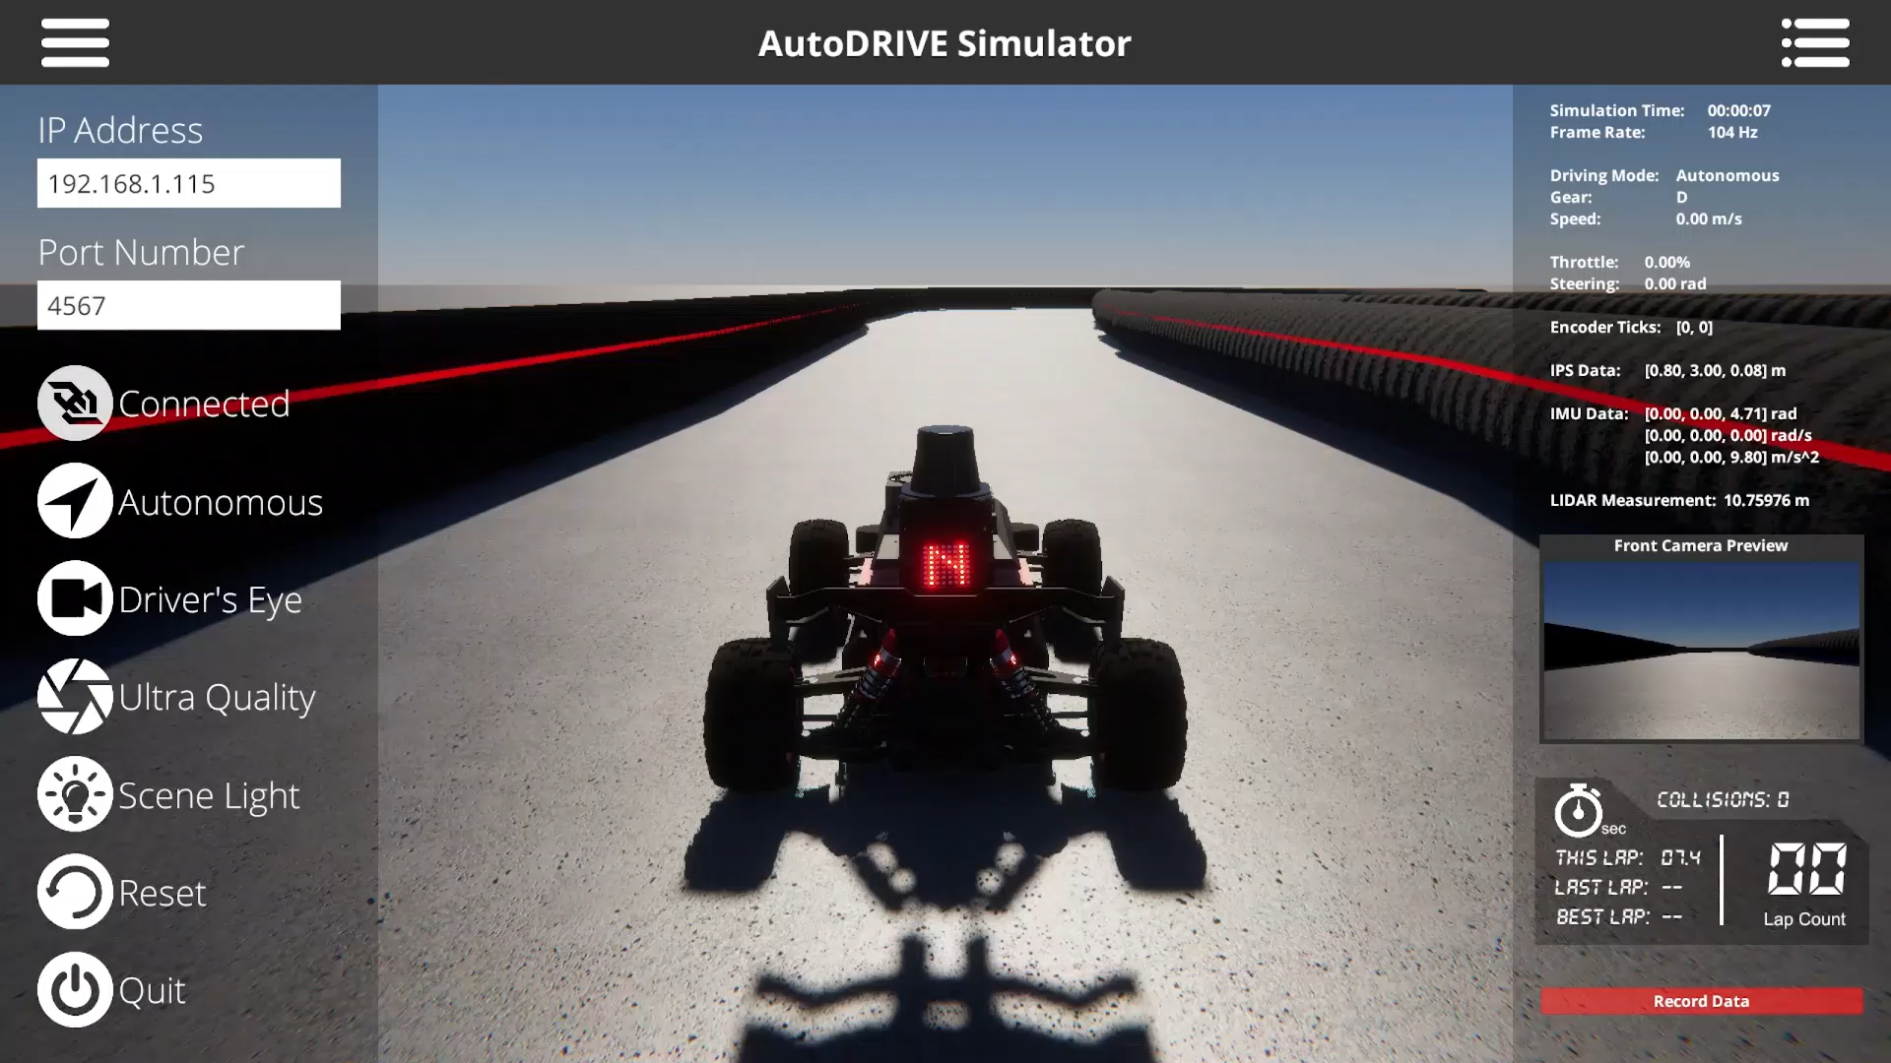

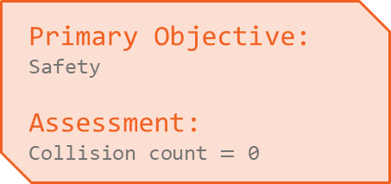
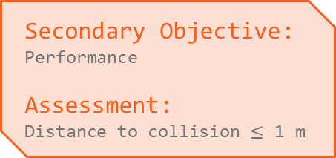
Emergency Braking Demo
Primary Objective:
Safety
Assessment:
Collision count $=$ 0
Secondary Objective:
Performance
Assessment:
Distance to collision $≤$ 1 m
Reference Code

Slide 7
Wall Following

Slide 8
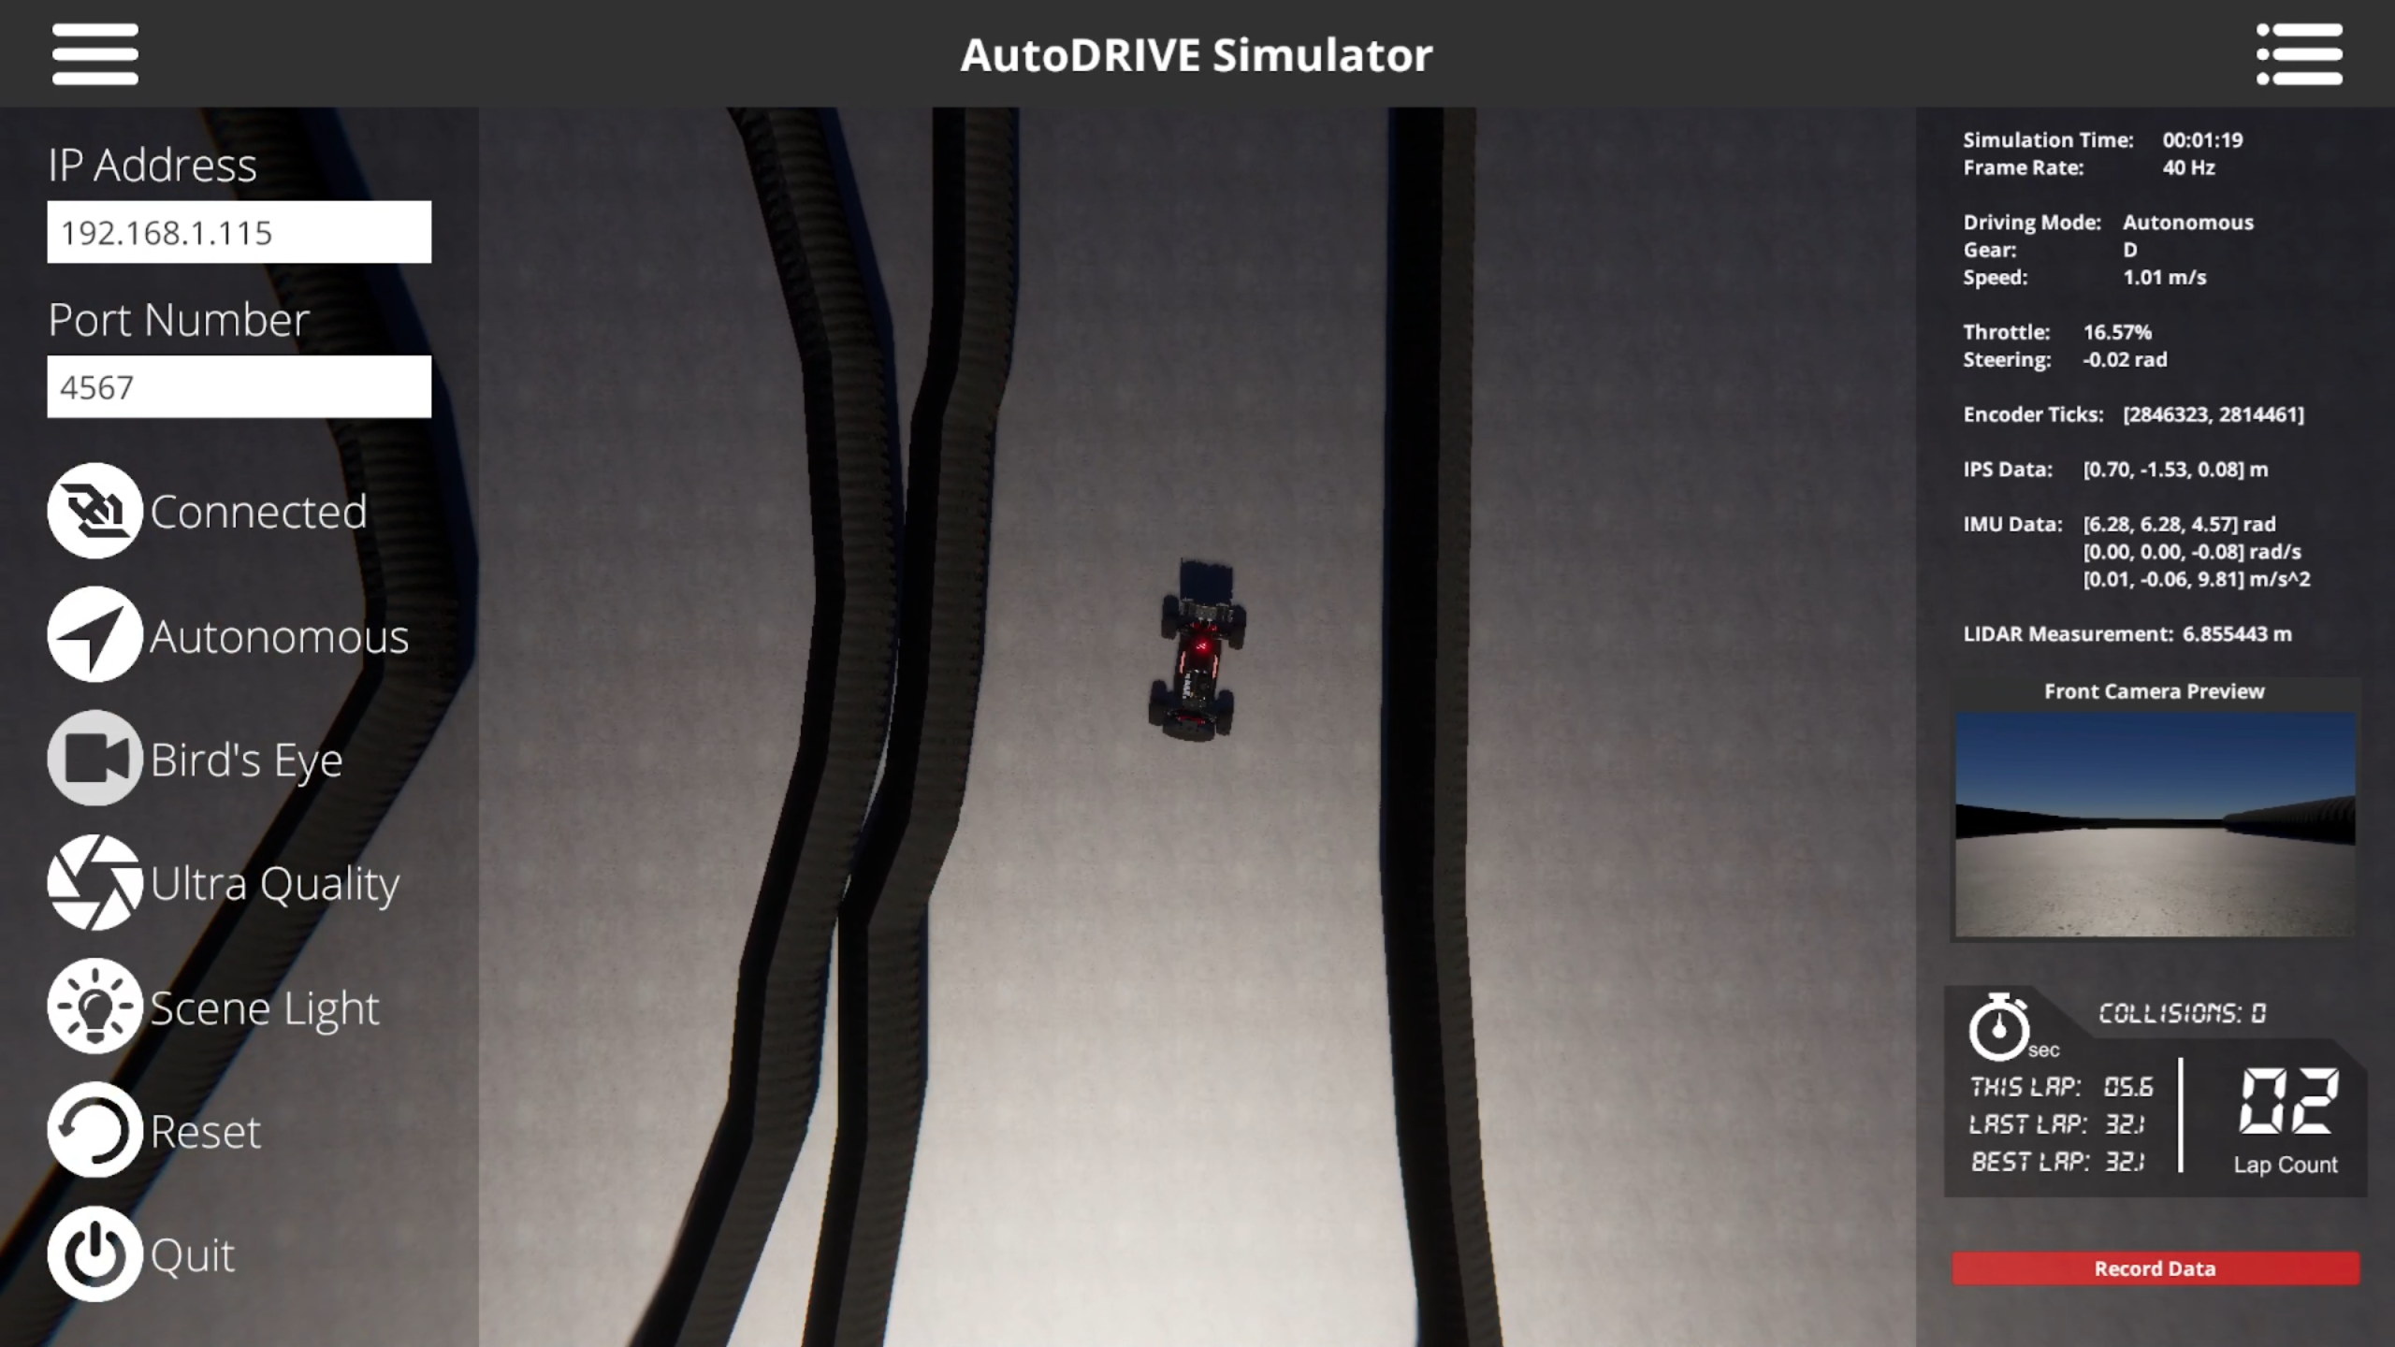



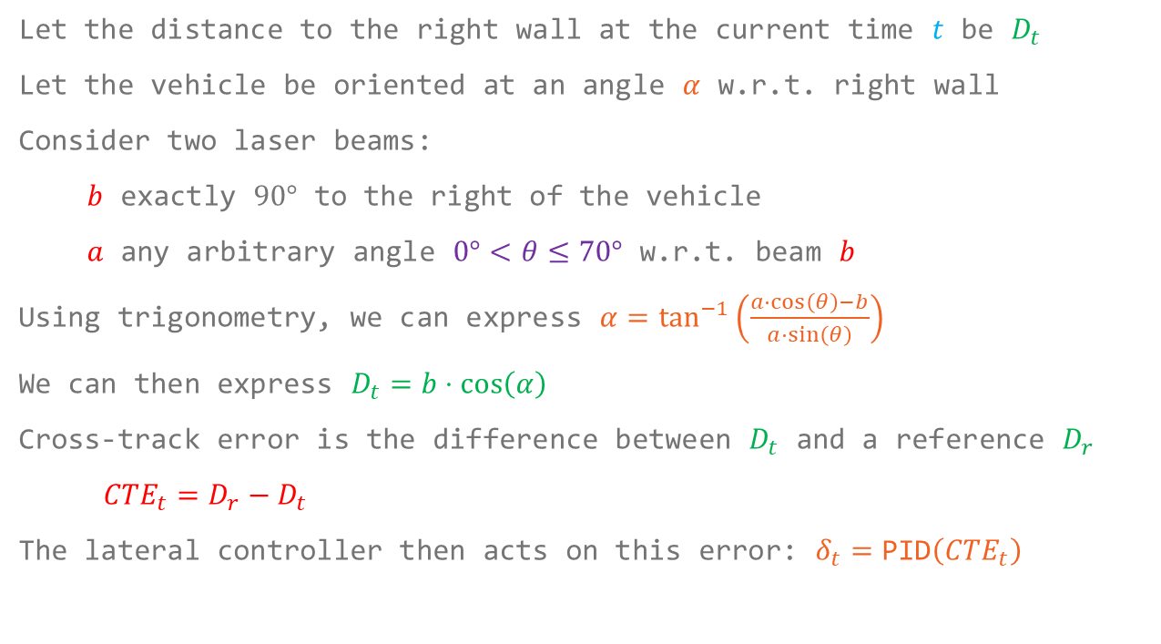






Formulation A: Follow Just One Wall
Let the distance to the right wall at the current time $t$ be $D_{t}$
Let the vehicle be oriented at an angle $α$ w.r.t. right wall
Consider two laser beams:
$b$ exactly $90°$ to the right of the vehicle
$a$ any arbitrary angle $0°<θ≤70°$ w.r.t. beam $b$
Using trigonometry, we can express $α=\tan^{−1}\left(\frac{a⋅\cos\left(θ\right)−b}{a⋅\sin\left(θ\right)}\right)$
We can then express $D_{t}=b⋅\cos\left(α\right)$
Cross-track error is the difference between $D_{t}$ and a reference $D_{r}$
${CTE}_{t}=D_{r}−D_{t}$
The lateral controller then acts on this error: $δ_{t}=\text{PID}\left({CTE}_{t}\right)$
$$α$$
$$a$$
$$θ$$
$$b$$
$$A$$
$$α$$
$$B$$
$$X_{t}$$
$$D_{t}=B−A$$

Slide 9


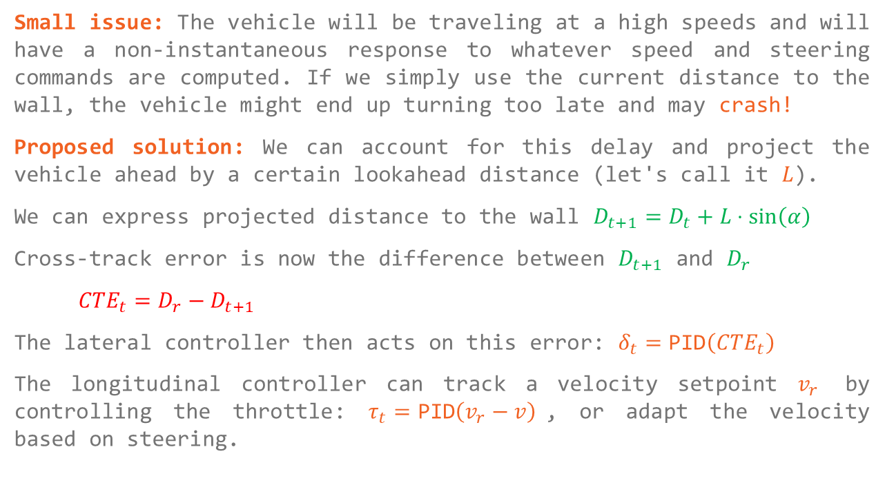








Formulation A: Follow Just One Wall
Small issue: The vehicle will be traveling at a high speeds and will have a non-instantaneous response to whatever speed and steering commands are computed. If we simply use the current distance to the wall, the vehicle might end up turning too late and may crash!
Proposed solution: We can account for this delay and project the vehicle ahead by a certain lookahead distance (let's call it $L$).
We can express projected distance to the wall $D_{t+1}=D_{t}+L⋅\sin\left(α\right)$
Cross-track error is now the difference between $D_{t+1}$ and $D_{r}$
${CTE}_{t}=D_{r}−D_{t+1}$
The lateral controller then acts on this error: $δ_{t}=\text{PID}\left({CTE}_{t}\right)$
The longitudinal controller can track a velocity setpoint $v_{r}$ by controlling the throttle: $τ_{t}=\text{PID}\left(v_{r}−v\right)$, or adapt the velocity based on steering.
$$Error$$
$$α$$
$$X_{t+1}$$
$$C$$
$$D$$
$$L$$
$$A$$
$$B$$
$$X_{t}$$
$$D_{t+1}=D−C$$

Slide 10

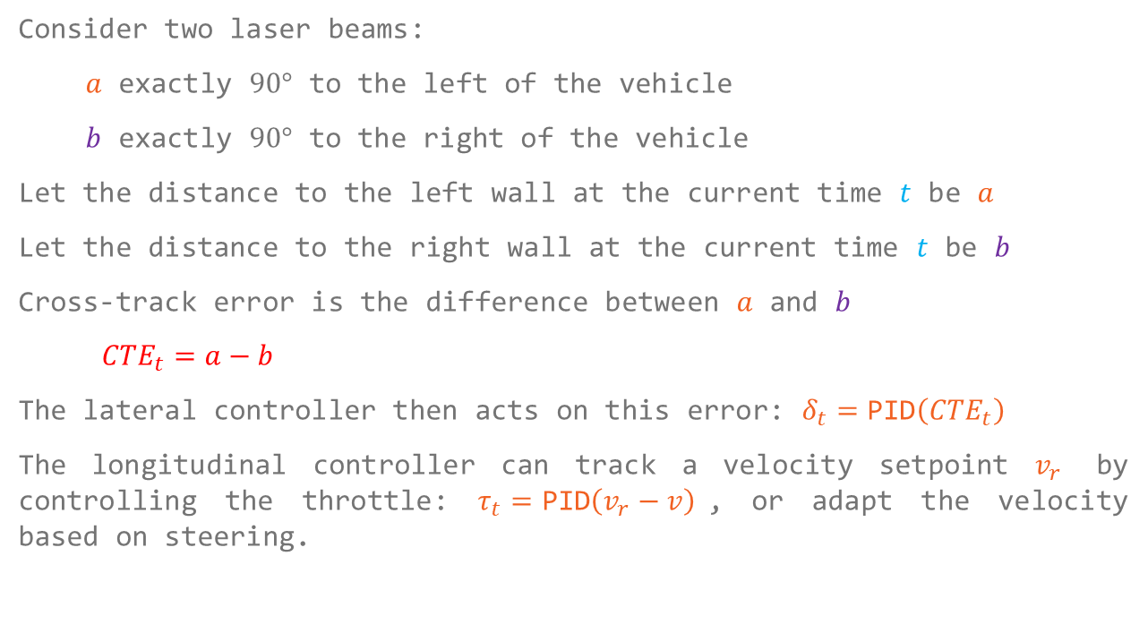


Formulation B: Follow Both the Walls
Consider two laser beams:
$a$ exactly $90°$ to the left of the vehicle
$b$ exactly $90°$ to the right of the vehicle
Let the distance to the left wall at the current time $t$ be $a$
Let the distance to the right wall at the current time $t$ be $b$
Cross-track error is the difference between $a$ and $b$
${CTE}_{t}=a−b$
The lateral controller then acts on this error: $δ_{t}=\text{PID}\left({CTE}_{t}\right)$
The longitudinal controller can track a velocity setpoint $v_{r}$ by controlling the throttle: $τ_{t}=\text{PID}\left(v_{r}−v\right)$, or adapt the velocity based on steering.
$$X_{t}$$
$$b$$
$$a$$

Slide 11
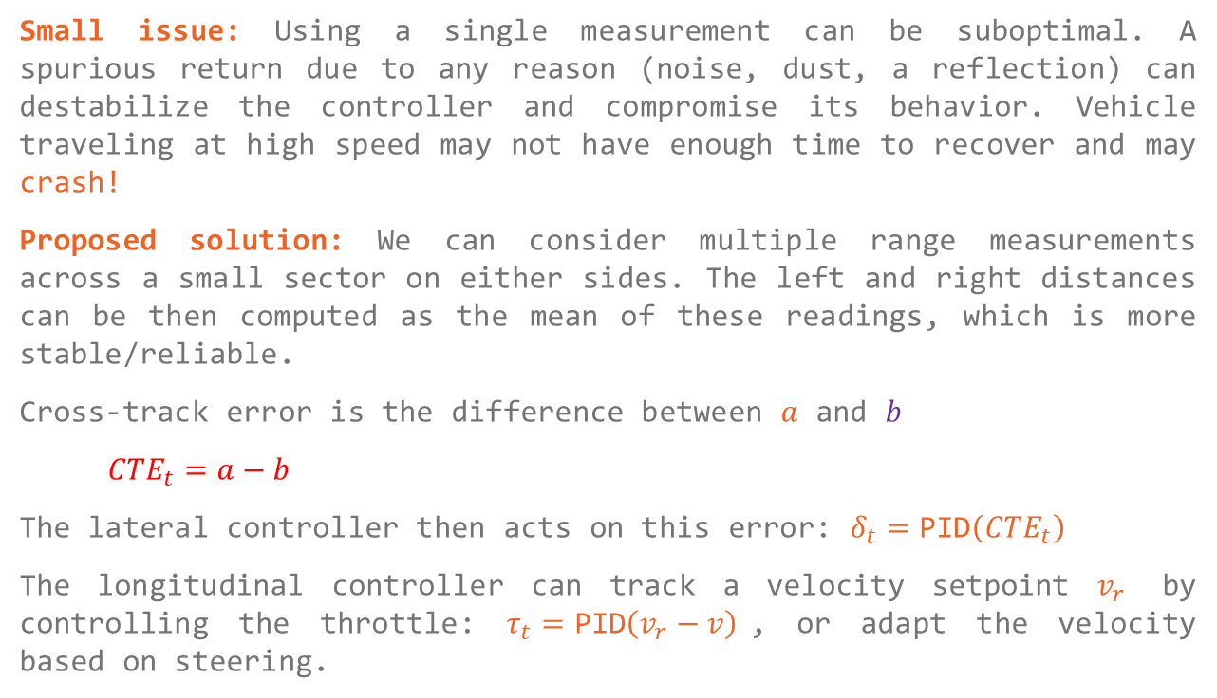
Formulation B: Follow Both the Walls
Small issue: Using a single measurement can be suboptimal. A spurious return due to any reason (noise, dust, a reflection) can destabilize the controller and compromise its behavior. Vehicle traveling at high speed may not have enough time to recover and may crash!
Proposed solution: We can consider multiple range measurements across a small sector on either sides. The left and right distances can be then computed as the mean of these readings, which is more stable/reliable.
Cross-track error is the difference between $a$ and $b$
${CTE}_{t}=a−b$
The lateral controller then acts on this error: $δ_{t}=\text{PID}\left({CTE}_{t}\right)$
The longitudinal controller can track a velocity setpoint $v_{r}$ by controlling the throttle: $τ_{t}=\text{PID}\left(v_{r}−v\right)$, or adapt the velocity based on steering.
$$X_{t}$$
$$b$$
$$a$$

Slide 12

Wall Following Demo
Primary Objective:
Safety
Assessment:
Collision count $=$ 0
Secondary Objective:
Performance
Assessment:
Minimize lap time
Reference Code

Slide 13
Gap Following

Slide 14
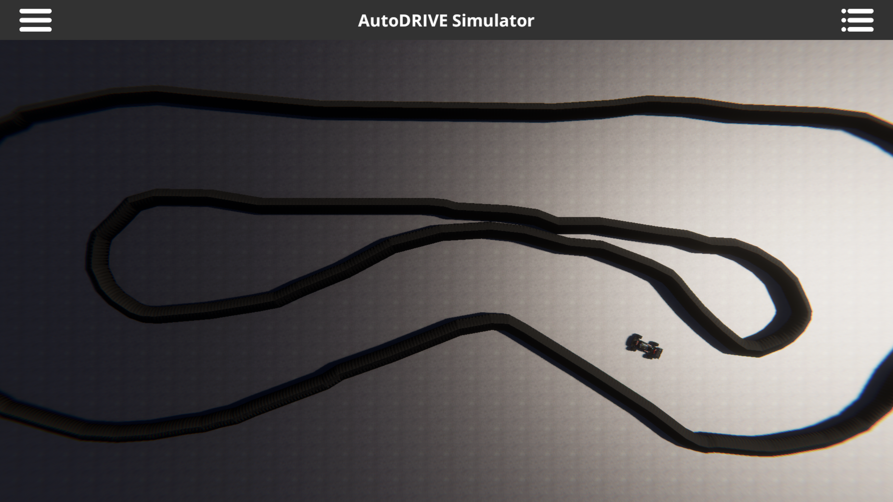
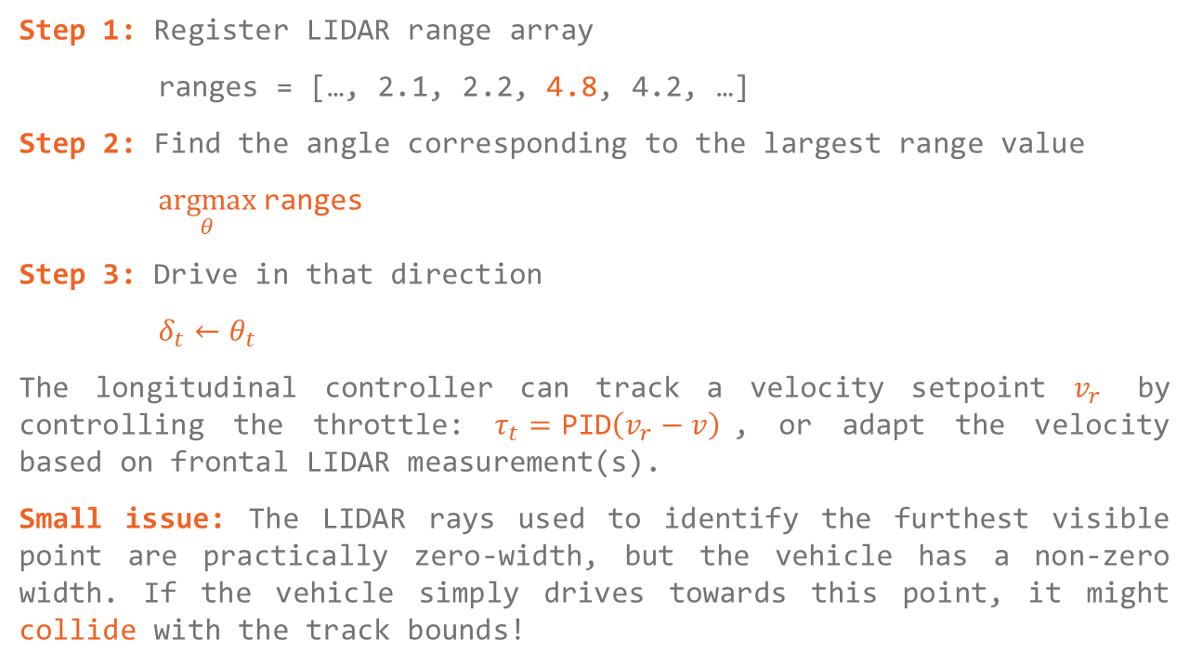
Formulation A: Naïve Gap Follower
Step 1: Register LIDAR range array
ranges = […, 2.1, 2.2, 4.8, 4.2, …]
Step 2: Find the angle corresponding to the largest range value
$\underset{θ}{argmax}{\text{ranges}}$
Step 3: Drive in that direction
$δ_{t}←θ_{t}$
The longitudinal controller can track a velocity setpoint $v_{r}$ by controlling the throttle: $τ_{t}=\text{PID}\left(v_{r}−v\right)$, or adapt the velocity based on frontal LIDAR measurement(s).
Small issue: The LIDAR rays used to identify the furthest visible point are practically zero-width, but the vehicle has a non-zero width. If the vehicle simply drives towards this point, it might collide with the track bounds!

Slide 15
Formulation A: Naïve Gap Follower
Step 1: Register LIDAR range array
ranges = […, 2.1, 2.2, 4.8, 4.2, …]
Step 2: Find the angle corresponding to the largest range value
$\underset{θ}{argmax}{\text{ranges}}$
Step 3: Drive in that direction
$δ_{t}←θ_{t}$
The longitudinal controller can track a velocity setpoint $v_{r}$ by controlling the throttle: $τ_{t}=\text{PID}\left(v_{r}−v\right)$, or adapt the velocity based on frontal LIDAR measurement(s).
Small issue: The LIDAR rays used to identify the furthest visible point are practically zero-width, but the vehicle has a non-zero width. If the vehicle simply drives towards this point, it might collide with the track bounds!

Slide 16
Formulation B: Disparity Extender
Proposed solution: We can account for the vehicle footprint by extending the disparity of LIDAR measurements.

Slide 17
Formulation B: Disparity Extender
Proposed solution: We can account for the vehicle footprint by extending the disparity of LIDAR measurements.
Step 1: Register LIDAR range array […, 2.1, 2.2, 4.8, 4.2, …]

Slide 18
Formulation B: Disparity Extender
Proposed solution: We can account for the vehicle footprint by extending the disparity of LIDAR measurements.
Step 1: Register LIDAR range array […, 2.1, 2.2, 4.8, 4.2, …]
Step 2: Filter frontal measurements […, 2.1, 2.2, 4.8, 4.2, …]

Slide 19
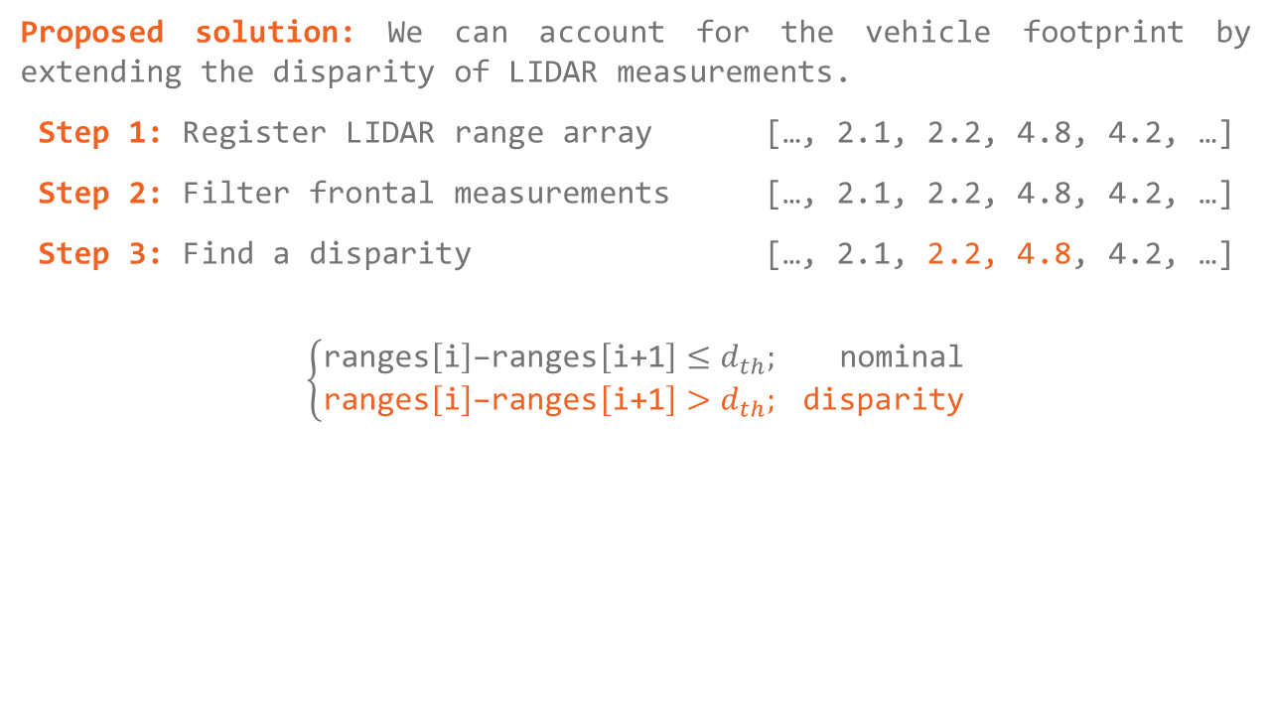
Formulation B: Disparity Extender
Proposed solution: We can account for the vehicle footprint by extending the disparity of LIDAR measurements.
Step 1: Register LIDAR range array […, 2.1, 2.2, 4.8, 4.2, …]
Step 2: Filter frontal measurements […, 2.1, 2.2, 4.8, 4.2, …]
Step 3: Find a disparity […, 2.1, 2.2, 4.8, 4.2, …]
$$\left\{\begin{aligned}\text{ranges}\left[\text{i}\right]\text{−}\text{ranges}\left[\text{i+1}\right]≤d_{th}; \text{nominal} \\ \text{ranges}\left[\text{i}\right]\text{−ranges}\left[\text{i+1}\right]>d_{th}; \text{disparity}\end{aligned}\right.$$

Slide 20
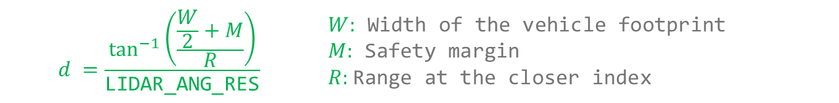

Formulation B: Disparity Extender
Proposed solution: We can account for the vehicle footprint by extending the disparity of LIDAR measurements.
Step 1: Register LIDAR range array […, 2.1, 2.2, 4.8, 4.2, …]
Step 2: Filter frontal measurements […, 2.1, 2.2, 4.8, 4.2, …]
Step 3: Find a disparity […, 2.1, 2.2, 4.8, 4.2, …]
Step 4: Extend the disparity […, 2.1, 2.2, 2.2, 2.2, …]
$$d$$
$$d =\frac{\tan^{−1}\left(\frac{\frac{W}{2}+M}{R}\right)}{\text{LIDAR_ANG_RES}}$$ | $W:$ Width of the vehicle footprint $M:$ Safety margin $R:$Range at the closer index

Slide 21
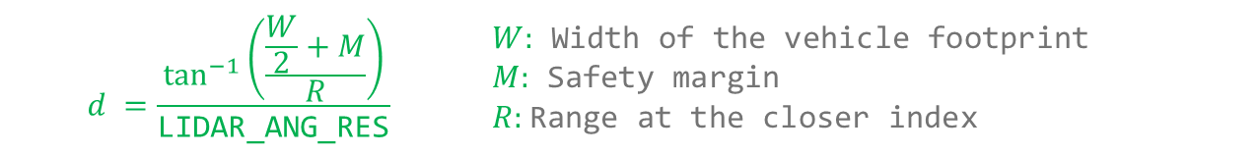
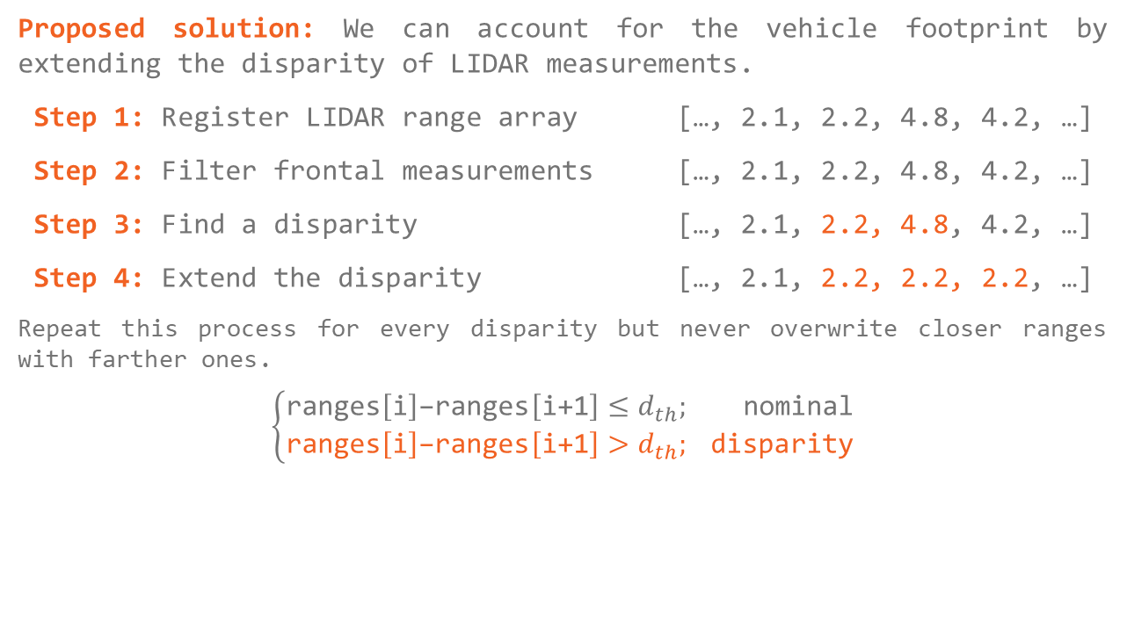
Formulation B: Disparity Extender
Proposed solution: We can account for the vehicle footprint by extending the disparity of LIDAR measurements.
Step 1: Register LIDAR range array […, 2.1, 2.2, 4.8, 4.2, …]
Step 2: Filter frontal measurements […, 2.1, 2.2, 4.8, 4.2, …]
Step 3: Find a disparity […, 2.1, 2.2, 4.8, 4.2, …]
Step 4: Extend the disparity […, 2.1, 2.2, 2.2, 2.2, …]
Repeat this process for every disparity but never overwrite closer ranges with farther ones.
$$\left\{\begin{aligned}\text{ranges}\left[\text{i}\right]\text{−ranges}\left[\text{i+1}\right]≤d_{th}; \text{nominal} \\ \text{ranges}\left[\text{i}\right]\text{−ranges}\left[\text{i+1}\right]>d_{th}; \text{disparity}\end{aligned}\right.$$
$$d$$
$$d =\frac{\tan^{−1}\left(\frac{\frac{W}{2}+M}{R}\right)}{\text{LIDAR_ANG_RES}}$$ | $W:$ Width of the vehicle footprint $M:$ Safety margin $R:$Range at the closer index

Slide 22
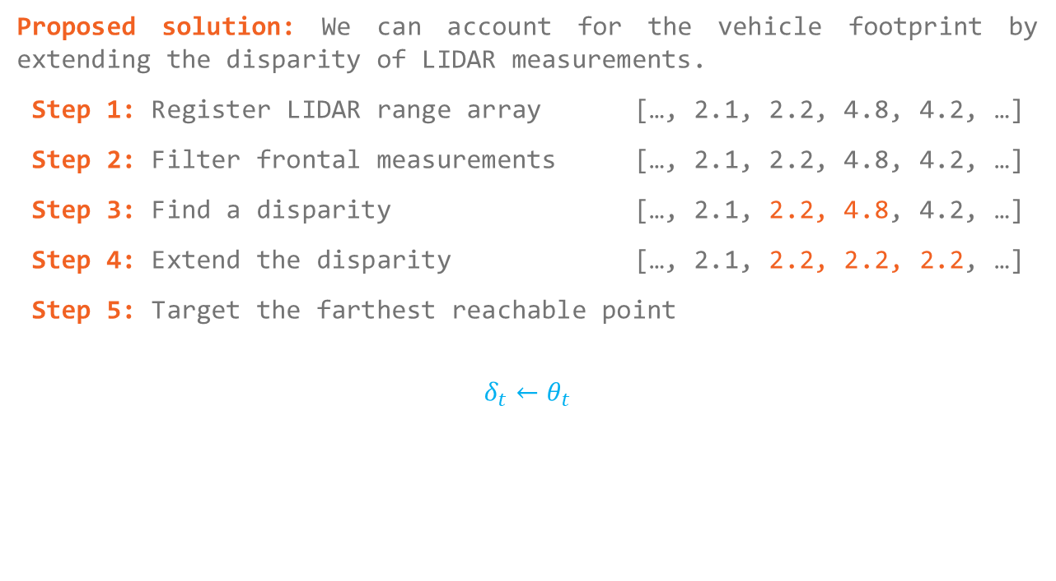
Formulation B: Disparity Extender
Proposed solution: We can account for the vehicle footprint by extending the disparity of LIDAR measurements.
Step 1: Register LIDAR range array […, 2.1, 2.2, 4.8, 4.2, …]
Step 2: Filter frontal measurements […, 2.1, 2.2, 4.8, 4.2, …]
Step 3: Find a disparity […, 2.1, 2.2, 4.8, 4.2, …]
Step 4: Extend the disparity […, 2.1, 2.2, 2.2, 2.2, …]
Step 5: Target the farthest reachable point
$$δ_{t}←θ_{t}$$
$$d$$

Slide 23
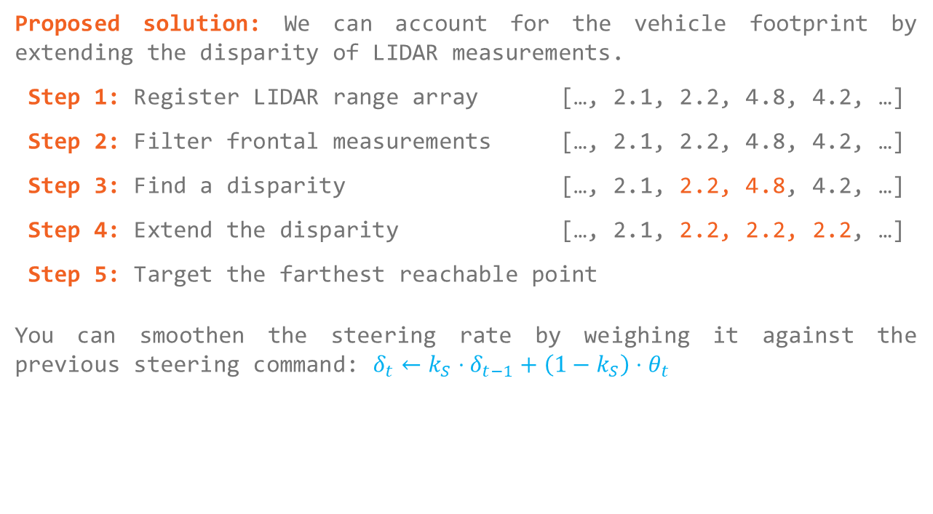
Formulation B: Disparity Extender
Proposed solution: We can account for the vehicle footprint by extending the disparity of LIDAR measurements.
Step 1: Register LIDAR range array […, 2.1, 2.2, 4.8, 4.2, …]
Step 2: Filter frontal measurements […, 2.1, 2.2, 4.8, 4.2, …]
Step 3: Find a disparity […, 2.1, 2.2, 4.8, 4.2, …]
Step 4: Extend the disparity […, 2.1, 2.2, 2.2, 2.2, …]
Step 5: Target the farthest reachable point
You can smoothen the steering rate by weighing it against the previous steering command: $δ_{t}←k_{S}⋅δ_{t−1}+\left(1−k_{S}\right)⋅θ_{t}$
$$d$$

Slide 24
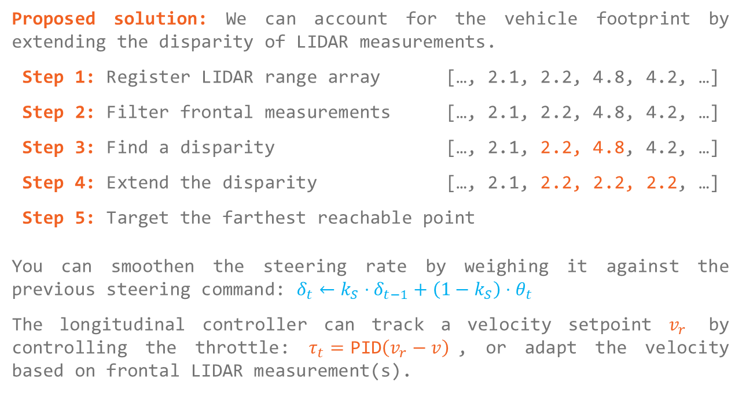
Formulation B: Disparity Extender
Proposed solution: We can account for the vehicle footprint by extending the disparity of LIDAR measurements.
Step 1: Register LIDAR range array […, 2.1, 2.2, 4.8, 4.2, …]
Step 2: Filter frontal measurements […, 2.1, 2.2, 4.8, 4.2, …]
Step 3: Find a disparity […, 2.1, 2.2, 4.8, 4.2, …]
Step 4: Extend the disparity […, 2.1, 2.2, 2.2, 2.2, …]
Step 5: Target the farthest reachable point
You can smoothen the steering rate by weighing it against the previous steering command: $δ_{t}←k_{S}⋅δ_{t−1}+\left(1−k_{S}\right)⋅θ_{t}$
The longitudinal controller can track a velocity setpoint $v_{r}$ by controlling the throttle: $τ_{t}=\text{PID}\left(v_{r}−v\right)$, or adapt the velocity based on frontal LIDAR measurement(s).
$$d$$

Slide 25
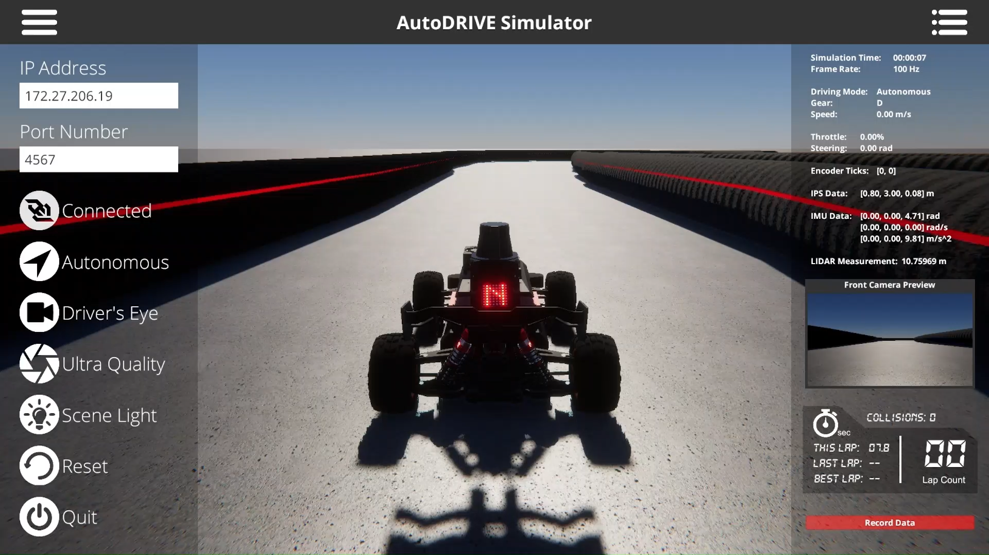
Gap Following Demo
Primary Objective:
Safety
Assessment:
Collision count $=$ 0
Secondary Objective:
Performance
Assessment:
Minimize lap time
Reference Code

Slide 26
Thank You!
Open to questions and discussion…

